Slide 1
Crypto Currency Dashboard

Slide 2

Project analysis slide 2
Introduction to
Cryptocurrency
Cryptocurrency:
A cryptocurrency is a digital or virtual currency that uses cryptography for security.
This makes it nearly impossible to counterfeit or double-spend.
Many cryptocurrencies operate on decentralized networks based on blockchain technology, which is a distributed ledger enforced by a network of computers.
Project Overview:
This project involves the analysis of various types of cryptocurrency over different years.
Dataset Link:
Cryptocurrency Price History Dataset

Slide 3
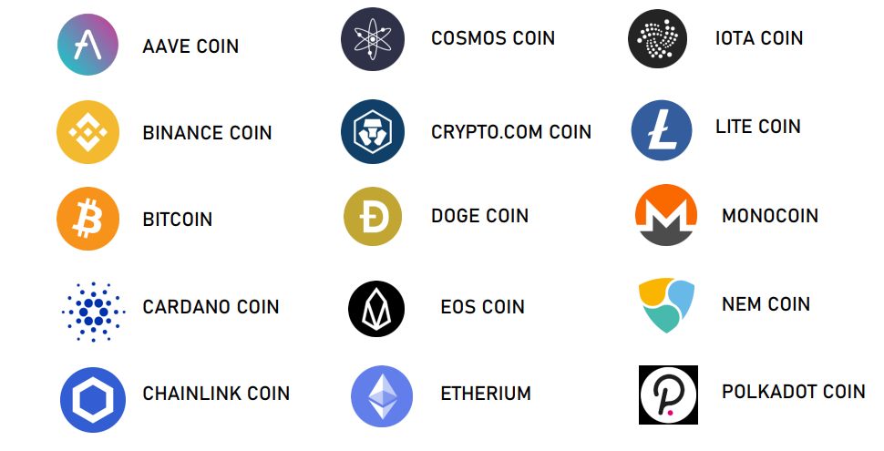
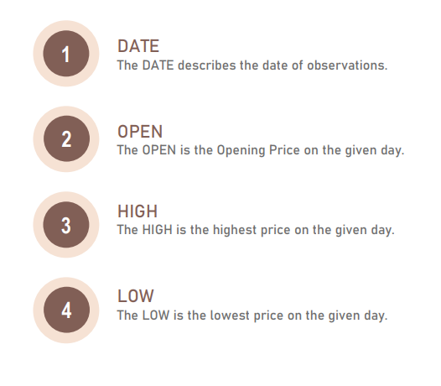
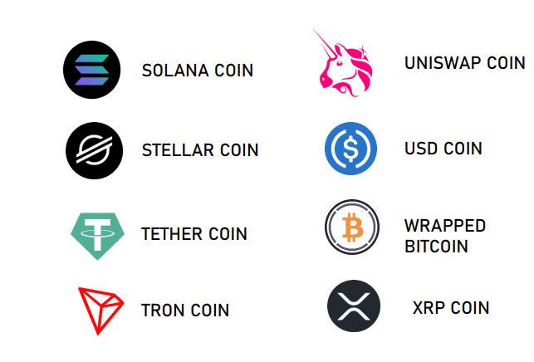
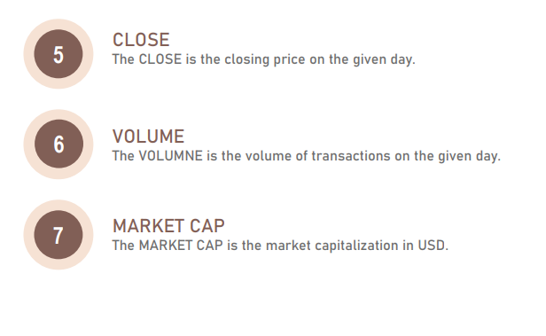
Project analysis slide 2
About the Dataset

Slide 4
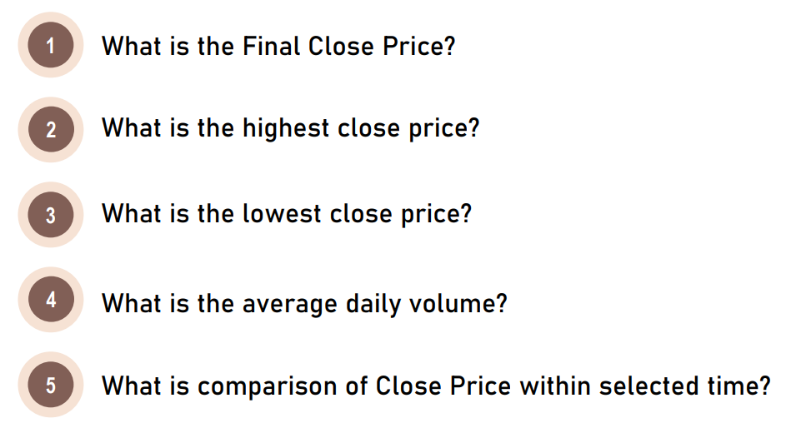
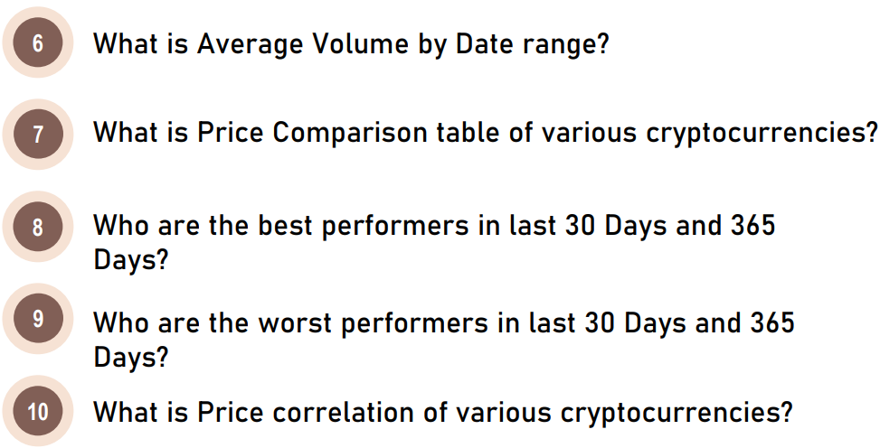
Project analysis slide 2
Insights to be found

Slide 5
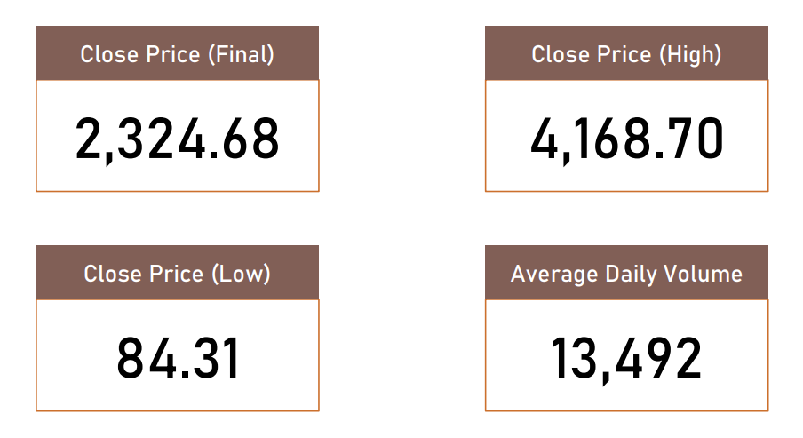
Project analysis slide 2
Visual Analytics &
Findings

Slide 6
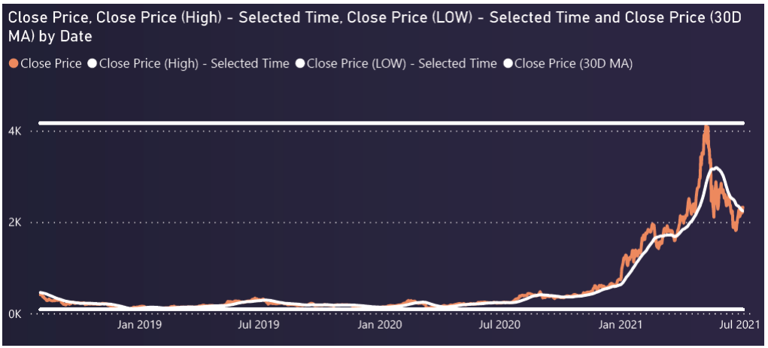
Project analysis slide 2
Overall Analysis
CLOSE PRICE WITHIN SELECTED DATE

Slide 7
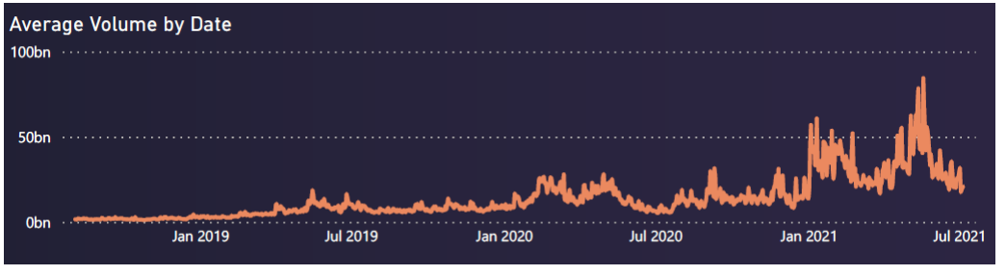
Project analysis slide 2
Overall Analysis
AVERAGE VOLUME BY DATE

Slide 8
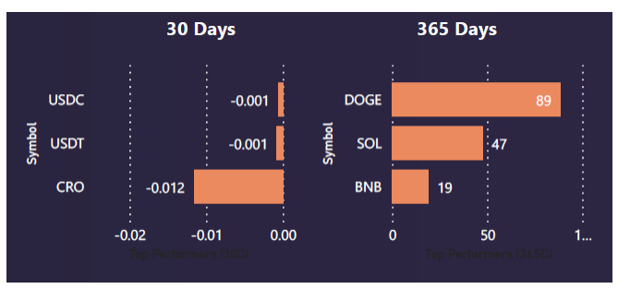
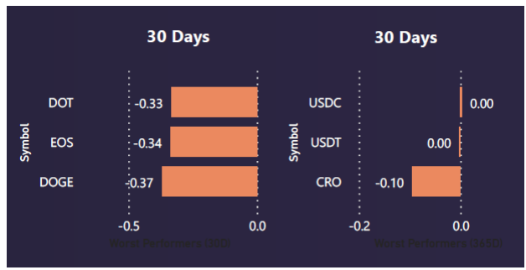
Project analysis slide 2
Overall Analysis
BEST PERFORMERS
WORST PERFORMERS

Slide 9
Thank You

